Slide 1




Data Structures
ADT List
Notes:
This version of ADT List slides have been modified by removing reference to LinkList. The type name used is just List. The ADT List can be implemented either as an array or a linked list.

Slide 2

ADT List
Elements
Structure
Domain
Operations
User of an ADT
must only
know this
Specification
Implementer must
know all these.
Representation
Implementation

Slide 3


ADT List: Specification
Elements: The elements are of generic type <Type> (The elements are placed in nodes for linked list implementation).
Structure: the elements are linearly arranged. The first element is called head, there is a element called current.
Domain: the number of elements in the list is bounded therefore the domain is finite. Type name of elements in the domain: List

Slide 4









ADT List: Specification
Operations: We assume all operations operate on a list L.
Method findFirst ( )
requires: list L is not empty. input: none
results: first element set as the current element. output: none.
Method findNext ( )
requires: list L is not empty. Current is not last. input: none
results: element following the current element is made the current element.
output: none.
Method retrieve (Type e)
requires: list L is not empty. input: none
results: current element is copied into e. output: element e.

Slide 5















ADT List: Specification
Operations:
Method update (Type e).
requires: list L is not empty. input: e.
results: the element e is copied into the current node.
output: none.
5. Method insert (Type e).
requires: list L is not full. input: e.
results: a new node containing element e is created and inserted after the current element in the list. The new element e is made the current element. If the list is empty e is also made the head element.
output: none.

Slide 6








ADT List: Specification
Operations:
Method remove ( )
requires: list L is not empty. input: none
results: the current element is removed from the list. If the resulting list is empty current is set to NULL. If successor of the deleted element exists it is made the new current element otherwise first element is made the new current element.
output: none.
7. Method full (boolean flag)
input: none.
returns: if the number of elements in L has reached the maximum number allowed then flag is set to true otherwise false.
output: flag.

Slide 7



ADT List: Specification
Operations:
Method empty (boolean flag).
input: none.
results: if the number of elements in L is zero, then flag is set to true otherwise false.
Output: flag.
Method last (boolean flag).
input: none. requires: L is not empty.
Results: if the last element is the current element then flag is set to true otherwise false.
Output: flag

Slide 8



Representation/Implementation
Programmers have to deal with the questions:
  How to represent lists? Storage structure affects the efficiency of the operations.
  How to implement the operations? Algorithm chosen must be efficient.
Lists can represented as
  Linked List
  Array based List

Slide 9






List (Linked List)
null
head
node
current
node

Slide 10







List (Array Based)
0
1
2
3
4
5
6
n-2
n-1
size
maxsize
current

Slide 11






List Interface
public interface List<T>{
  public void findFirst( );
  public void findNext( );
  public T retrieve( );
  public void update(T e);
  public void insert(T e);
  public void remove( );
  public boolean full( );
  public boolean empty( );
  public boolean last( );
}

Slide 12

ADT List (Linked List): Element
public class Node<T> {
public T data;
public Node<T> next;
public Node () {
data = null;
next = null;
}
public Node (T val) {
data = val;
next = null;
}
// Setters/Getters...
}

Slide 13


ADT List (Linked List): Representation
public class LinkedList<T> implements List<T>{
private Node<T> head;
private Node<T> current;
public LinkedList () {
head = current = null;
}
public boolean empty () {
return head == null;
}
public boolean last () {
return current.next == null;
}

Slide 14
ADT List (Linked List): Representation
public class LinkedList<T> implements List<T>{
private Node<T> head;
private Node<T> current;
public LinkedList () {
head = current = null;
}
public boolean empty () {
return head == null;
}
public boolean last () {
return current.next == null;
}
H
H
null
…
true
false

Slide 15
ADT List (Linked List): Representation
public class LinkedList<T> implements List<T>{
private Node<T> head;
private Node<T> current;
public LinkedList () {
head = current = null;
}
public boolean empty () {
return head == null;
}
public boolean last () {
return current.next == null;
}
H
C
…
…
null
false
H
C
…
…
null
true

Slide 16
ADT List (Linked List): Implementation
public boolean full () {
return false;
}
public void findfirst () {
current = head;
}
public void findnext () {
current = current.next;
}
public T retrieve () {
return current.data;
}
public void update (T val) {
current.data = val;
}

Slide 17
ADT List (Linked List): Implementation
public boolean full () {
return false;
}
public void findfirst () {
current = head;
}
public void findnext () {
current = current.next;
}
public T retrieve () {
return current.data;
}
public void update (T val) {
current.data = val;
}
H
C
…
…
null
H
C
…
…
null

Slide 18
ADT List (Linked List): Implementation
H
C
public boolean full () {
return false;
}
public void findfirst () {
current = head;
}
public void findnext () {
current = current.next;
}
public T retrieve () {
return current.data;
}
public void update (T val) {
current.data = val;
}
…
…
null
H
C
…
…
null

Slide 19


ADT List (Linked List): Implementation
public boolean full () {
return false;
}
public void findfirst () {
current = head;
}
public void findnext () {
current = current.next;
}
public T retrieve () {
return current.data;
}
public void update (T val) {
current.data = val;
}
H
C
…
…
null
current.data

Slide 20




ADT List (Linked List): Implementation
public boolean full () {
return false;
}
public void findfirst () {
current = head;
}
public void findnext () {
current = current.next;
}
public T retrieve () {
return current.data;
}
public void update (T val) {
current.data = val;
}
H
C
…
…
null
val

Slide 21
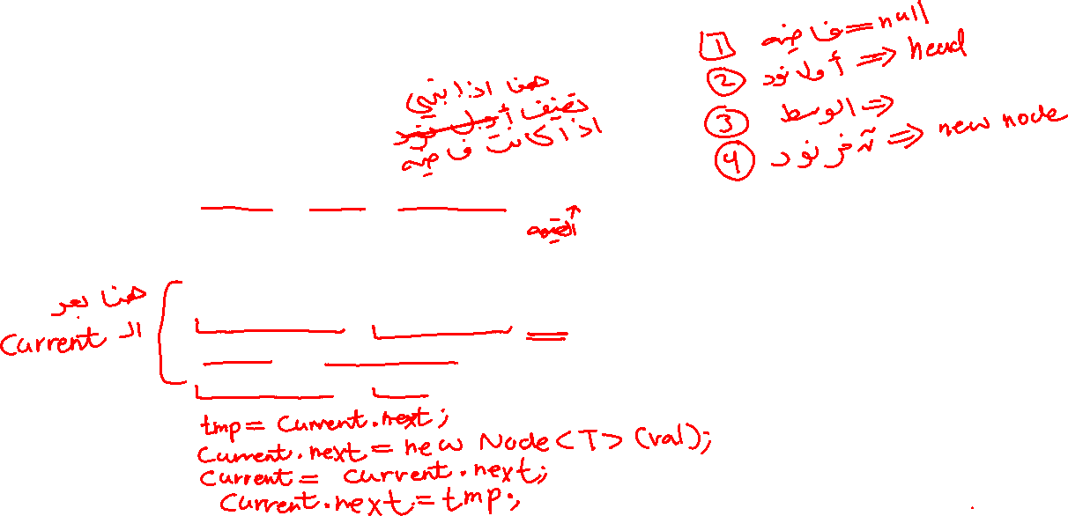

ADT List (Linked List): Implementation
public void insert (T val) {
Node<T> tmp;
if (empty()) {
current = head = new Node<T> (val);
}
else {
tmp = current.next;
current.next = new Node<T> (val);
current = current.next;
current.next = tmp;
}
}

Slide 22
ADT List (Linked List): Implementation
Example #1
H
C
public void insert (T val) {
Node<T> tmp;
if (empty()) {
current = head = new Node<T> (val);
}
else {
tmp = current.next;
current.next = new Node<T> (val);
current = current.next;
current.next = tmp;
}
}
null
H
C
null

Slide 23
ADT List (Linked List): Implementation
public void insert (T val) {
Node<T> tmp;
if (empty()) {
current = head = new Node<T> (val);
}
else {
tmp = current.next;
current.next = new Node<T> (val);
current = current.next;
current.next = tmp;
}
}
H
C
Example #2
null

Slide 24
ADT List (Linked List): Implementation
public void insert (T val) {
Node<T> tmp;
if (empty()) {
current = head = new Node<T> (val);
}
else {
tmp = current.next;
current.next = new Node<T> (val);
current = current.next;
current.next = tmp;
}
}
H
C
tmp
Example #2
null

Slide 25
ADT List (Linked List): Implementation
public void insert (T val) {
Node<T> tmp;
if (empty()) {
current = head = new Node<T> (val);
}
else {
tmp = current.next;
current.next = new Node<T> (val);
current = current.next;
current.next = tmp;
}
}
H
C
tmp
Example #2
null

Slide 26
ADT List (Linked List): Implementation
public void insert (T val) {
Node<T> tmp;
if (empty()) {
current = head = new Node<T> (val);
}
else {
tmp = current.next;
current.next = new Node<T> (val);
current = current.next;
current.next = tmp;
}
}
H
C
tmp
Example #2
null

Slide 27
ADT List (Linked List): Implementation
public void insert (T val) {
Node<T> tmp;
if (empty()) {
current = head = new Node<T> (val);
}
else {
tmp = current.next;
current.next = new Node<T> (val);
current = current.next;
current.next = tmp;
}
}
H
C
tmp
Example #2
null

Slide 28
ADT List (Linked List): Implementation
public void insert (T val) {
Node<T> tmp;
if (empty()) {
current = head = new Node<T> (val);
}
else {
tmp = current.next;
current.next = new Node<T> (val);
current = current.next;
current.next = tmp;
}
}
H
C
Example #2
null

Slide 29
ADT List (Linked List): Implementation
public void insert (T val) {
Node<T> tmp;
if (empty()) {
current = head = new Node<T> (val);
}
else {
tmp = current.next;
current.next = new Node<T> (val);
current = current.next;
current.next = tmp;
}
}
H
C
Example #3
…

Slide 30
ADT List (Linked List): Implementation
public void insert (T val) {
Node<T> tmp;
if (empty()) {
current = head = new Node<T> (val);
}
else {
tmp = current.next;
current.next = new Node<T> (val);
current = current.next;
current.next = tmp;
}
}
H
C
tmp
Example #3
…

Slide 31
ADT List (Linked List): Implementation
public void insert (T val) {
Node<T> tmp;
if (empty()) {
current = head = new Node<T> (val);
}
else {
tmp = current.next;
current.next = new Node<T> (val);
current = current.next;
current.next = tmp;
}
}
H
C
tmp
Example #3
…

Slide 32
ADT List (Linked List): Implementation
public void insert (T val) {
Node<T> tmp;
if (empty()) {
current = head = new Node<T> (val);
}
else {
tmp = current.next;
current.next = new Node<T> (val);
current = current.next;
current.next = tmp;
}
}
H
C
tmp
Example #3
…

Slide 33
ADT List (Linked List): Implementation
public void insert (T val) {
Node<T> tmp;
if (empty()) {
current = head = new Node<T> (val);
}
else {
tmp = current.next;
current.next = new Node<T> (val);
current = current.next;
current.next = tmp;
}
}
H
C
tmp
Example #3
…

Slide 34
ADT List (Linked List): Implementation
public void insert (T val) {
Node<T> tmp;
if (empty()) {
current = head = new Node<T> (val);
}
else {
tmp = current.next;
current.next = new Node<T> (val);
current = current.next;
current.next = tmp;
}
}
H
C
Example #3
…

Slide 35
ADT List (Linked List): Implementation
public void insert (T val) {
Node<T> tmp;
if (empty()) {
current = head = new Node<T> (val);
}
else {
tmp = current.next;
current.next = new Node<T> (val);
current = current.next;
current.next = tmp;
}
}
H
C
Example #4
…
…
null

Slide 36
ADT List (Linked List): Implementation
public void insert (T val) {
Node<T> tmp;
if (empty()) {
current = head = new Node<T> (val);
}
else {
tmp = current.next;
current.next = new Node<T> (val);
current = current.next;
current.next = tmp;
}
}
H
C
tmp
Example #4
…
…
null

Slide 37
ADT List (Linked List): Implementation
public void insert (T val) {
Node<T> tmp;
if (empty()) {
current = head = new Node<T> (val);
}
else {
tmp = current.next;
current.next = new Node<T> (val);
current = current.next;
current.next = tmp;
}
}
H
C
tmp
Example #4
…
…
null

Slide 38
ADT List (Linked List): Implementation
public void insert (T val) {
Node<T> tmp;
if (empty()) {
current = head = new Node<T> (val);
}
else {
tmp = current.next;
current.next = new Node<T> (val);
current = current.next;
current.next = tmp;
}
}
H
C
tmp
Example #4
…
…
null

Slide 39
ADT List (Linked List): Implementation
public void insert (T val) {
Node<T> tmp;
if (empty()) {
current = head = new Node<T> (val);
}
else {
tmp = current.next;
current.next = new Node<T> (val);
current = current.next;
current.next = tmp;
}
}
H
C
tmp
Example #4
…
…
null

Slide 40
ADT List (Linked List): Implementation
public void insert (T val) {
Node<T> tmp;
if (empty()) {
current = head = new Node<T> (val);
}
else {
tmp = current.next;
current.next = new Node<T> (val);
current = current.next;
current.next = tmp;
}
}
H
C
Example #4
…
…
null

Slide 41
ADT List (Linked List): Implementation
public void insert (T val) {
Node<T> tmp;
if (empty()) {
current = head = new Node<T> (val);
}
else {
tmp = current.next;
current.next = new Node<T> (val);
current = current.next;
current.next = tmp;
}
}
H
C
Example #5
…
null

Slide 42
ADT List (Linked List): Implementation
public void insert (T val) {
Node<T> tmp;
if (empty()) {
current = head = new Node<T> (val);
}
else {
tmp = current.next;
current.next = new Node<T> (val);
current = current.next;
current.next = tmp;
}
}
H
C
tmp
Example #5
…
null

Slide 43
ADT List (Linked List): Implementation
public void insert (T val) {
Node<T> tmp;
if (empty()) {
current = head = new Node<T> (val);
}
else {
tmp = current.next;
current.next = new Node<T> (val);
current = current.next;
current.next = tmp;
}
}
H
C
tmp
Example #5
…
null

Slide 44
ADT List (Linked List): Implementation
public void insert (T val) {
Node<T> tmp;
if (empty()) {
current = head = new Node<T> (val);
}
else {
tmp = current.next;
current.next = new Node<T> (val);
current = current.next;
current.next = tmp;
}
}
H
C
tmp
Example #5
…
null

Slide 45
ADT List (Linked List): Implementation
public void insert (T val) {
Node<T> tmp;
if (empty()) {
current = head = new Node<T> (val);
}
else {
tmp = current.next;
current.next = new Node<T> (val);
current = current.next;
current.next = tmp;
}
}
H
C
tmp
Example #5
…
null

Slide 46
ADT List (Linked List): Implementation
public void insert (T val) {
Node<T> tmp;
if (empty()) {
current = head = new Node<T> (val);
}
else {
tmp = current.next;
current.next = new Node<T> (val);
current = current.next;
current.next = tmp;
}
}
H
C
Example #5
…
null

Slide 47
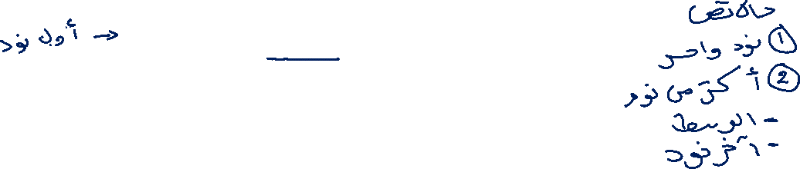
ADT List (Linked List): Implementation
public void remove () {
if (current == head) {
head = head.next;
}
else {
Node<T> tmp = head;
while (tmp.next != current)
tmp = tmp.next;
tmp.next = current.next;
}
if (current.next == null)
current = head;
else
current = current.next;
}
}

Slide 48

ADT List (Linked List): Implementation
H
C
public void remove () {
if (current == head) {
head = head.next;
}
else {
Node<T> tmp = head;
while (tmp.next != current)
tmp = tmp.next;
tmp.next = current.next;
}
if (current.next == null)
current = head;
else
current = current.next;
}
}
…
Example #1

Slide 49

ADT List (Linked List): Implementation
C
H
public void remove () {
if (current == head) {
head = head.next;
}
else {
Node<T> tmp = head;
while (tmp.next != current)
tmp = tmp.next;
tmp.next = current.next;
}
if (current.next == null)
current = head;
else
current = current.next;
}
}
…
Example #1

Slide 50
ADT List (Linked List): Implementation
H
C
public void remove () {
if (current == head) {
head = head.next;
}
else {
Node<T> tmp = head;
while (tmp.next != current)
tmp = tmp.next;
tmp.next = current.next;
}
if (current.next == null)
current = head;
else
current = current.next;
}
}
…
Example #1

Slide 51
ADT List (Linked List): Implementation
H
C
public void remove () {
if (current == head) {
head = head.next;
}
else {
Node<T> tmp = head;
while (tmp.next != current)
tmp = tmp.next;
tmp.next = current.next;
}
if (current.next == null)
current = head;
else
current = current.next;
}
}
…
Example #1

Slide 52
ADT List (Linked List): Implementation
H
C
public void remove () {
if (current == head) {
head = head.next;
}
else {
Node<T> tmp = head;
while (tmp.next != current)
tmp = tmp.next;
tmp.next = current.next;
}
if (current.next == null)
current = head;
else
current = current.next;
}
}
…
Example #1

Slide 53
ADT List (Linked List): Implementation
H
C
public void remove () {
if (current == head) {
head = head.next;
}
else {
Node<T> tmp = head;
while (tmp.next != current)
tmp = tmp.next;
tmp.next = current.next;
}
if (current.next == null)
current = head;
else
current = current.next;
}
}
null
Example #2

Slide 54

ADT List (Linked List): Implementation
C
H
public void remove () {
if (current == head) {
head = head.next;
}
else {
Node<T> tmp = head;
while (tmp.next != current)
tmp = tmp.next;
tmp.next = current.next;
}
if (current.next == null)
current = head;
else
current = current.next;
}
}
null
Example #2

Slide 55

ADT List (Linked List): Implementation
H
C
public void remove () {
if (current == head) {
head = head.next;
}
else {
Node<T> tmp = head;
while (tmp.next != current)
tmp = tmp.next;
tmp.next = current.next;
}
if (current.next == null)
current = head;
else
current = current.next;
}
}
null
Example #2

Slide 56
ADT List (Linked List): Implementation
H
C
public void remove () {
if (current == head) {
head = head.next;
}
else {
Node<T> tmp = head;
while (tmp.next != current)
tmp = tmp.next;
tmp.next = current.next;
}
if (current.next == null)
current = head;
else
current = current.next;
}
}
null
Example #2

Slide 57

ADT List (Linked List): Implementation
H
C
public void remove () {
if (current == head) {
head = head.next;
}
else {
Node<T> tmp = head;
while (tmp.next != current)
tmp = tmp.next;
tmp.next = current.next;
}
if (current.next == null)
current = head;
else
current = current.next;
}
}
null
Example #2

Slide 58

ADT List (Linked List): Implementation
H
C
public void remove () {
if (current == head) {
head = head.next;
}
else {
Node<T> tmp = head;
while (tmp.next != current)
tmp = tmp.next;
tmp.next = current.next;
}
if (current.next == null)
current = head;
else
current = current.next;
}
}
…
…
null
Example #3

Slide 59

ADT List (Linked List): Implementation
H
tmp
C
public void remove () {
if (current == head) {
head = head.next;
}
else {
Node<T> tmp = head;
while (tmp.next != current)
tmp = tmp.next;
tmp.next = current.next;
}
if (current.next == null)
current = head;
else
current = current.next;
}
}
…
…
null
Example #3

Slide 60

ADT List (Linked List): Implementation
H
tmp
C
public void remove () {
if (current == head) {
head = head.next;
}
else {
Node<T> tmp = head;
while (tmp.next != current)
tmp = tmp.next;
tmp.next = current.next;
}
if (current.next == null)
current = head;
else
current = current.next;
}
}
…
…
null
Example #3

Slide 61

ADT List (Linked List): Implementation
H
tmp
C
public void remove () {
if (current == head) {
head = head.next;
}
else {
Node<T> tmp = head;
while (tmp.next != current)
tmp = tmp.next;
tmp.next = current.next;
}
if (current.next == null)
current = head;
else
current = current.next;
}
}
…
…
null
Example #3

Slide 62

ADT List (Linked List): Implementation
H
tmp
C
public void remove () {
if (current == head) {
head = head.next;
}
else {
Node<T> tmp = head;
while (tmp.next != current)
tmp = tmp.next;
tmp.next = current.next;
}
if (current.next == null)
current = head;
else
current = current.next;
}
}
…
…
null
Example #3

Slide 63
ADT List (Linked List): Implementation
H
tmp
C
public void remove () {
if (current == head) {
head = head.next;
}
else {
Node<T> tmp = head;
while (tmp.next != current)
tmp = tmp.next;
tmp.next = current.next;
}
if (current.next == null)
current = head;
else
current = current.next;
}
}
…
…
null
Example #3

Slide 64
ADT List (Linked List): Implementation
H
C
public void remove () {
if (current == head) {
head = head.next;
}
else {
Node<T> tmp = head;
while (tmp.next != current)
tmp = tmp.next;
tmp.next = current.next;
}
if (current.next == null)
current = head;
else
current = current.next;
}
}
…
…
null
Example #3

Slide 65
ADT List (Linked List): Implementation
H
C
public void remove () {
if (current == head) {
head = head.next;
}
else {
Node<T> tmp = head;
while (tmp.next != current)
tmp = tmp.next;
tmp.next = current.next;
}
if (current.next == null)
current = head;
else
current = current.next;
}
}
…
…
null
Example #3

Slide 66

ADT List (Linked List): Implementation
H
C
public void remove () {
if (current == head) {
head = head.next;
}
else {
Node<T> tmp = head;
while (tmp.next != current)
tmp = tmp.next;
tmp.next = current.next;
}
if (current.next == null)
current = head;
else
current = current.next;
}
}
…
null
Example #4

Slide 67
ADT List (Linked List): Implementation
H
tmp
C
public void remove () {
if (current == head) {
head = head.next;
}
else {
Node<T> tmp = head;
while (tmp.next != current)
tmp = tmp.next;
tmp.next = current.next;
}
if (current.next == null)
current = head;
else
current = current.next;
}
}
…
null
Example #4

Slide 68

ADT List (Linked List): Implementation
H
tmp
C
public void remove () {
if (current == head) {
head = head.next;
}
else {
Node<T> tmp = head;
while (tmp.next != current)
tmp = tmp.next;
tmp.next = current.next;
}
if (current.next == null)
current = head;
else
current = current.next;
}
}
…
null
Example #4

Slide 69
ADT List (Linked List): Implementation
H
tmp
C
public void remove () {
if (current == head) {
head = head.next;
}
else {
Node<T> tmp = head;
while (tmp.next != current)
tmp = tmp.next;
tmp.next = current.next;
}
if (current.next == null)
current = head;
else
current = current.next;
}
}
…
null
Example #4

Slide 70
ADT List (Linked List): Implementation
H
tmp
C
public void remove () {
if (current == head) {
head = head.next;
}
else {
Node<T> tmp = head;
while (tmp.next != current)
tmp = tmp.next;
tmp.next = current.next;
}
if (current.next == null)
current = head;
else
current = current.next;
}
}
…
null
Example #4

Slide 71
ADT List (Linked List): Implementation
H
C
tmp
public void remove () {
if (current == head) {
head = head.next;
}
else {
Node<T> tmp = head;
while (tmp.next != current)
tmp = tmp.next;
tmp.next = current.next;
}
if (current.next == null)
current = head;
else
current = current.next;
}
}
…
null
Example #4

Slide 72
ADT List (Linked List): Implementation
H
C
public void remove () {
if (current == head) {
head = head.next;
}
else {
Node<T> tmp = head;
while (tmp.next != current)
tmp = tmp.next;
tmp.next = current.next;
}
if (current.next == null)
current = head;
else
current = current.next;
}
}
…
null
Example #4

Slide 73

ADT List (Linked List): Implementation
H
C
public void remove () {
if (current == head) {
head = head.next;
}
else {
Node<T> tmp = head;
while (tmp.next != current)
tmp = tmp.next;
tmp.next = current.next;
}
if (current.next == null)
current = head;
else
current = current.next;
}
}
…
null
Example #4

Slide 74

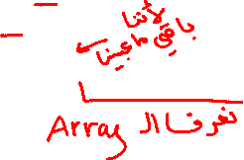

ADT List (Array): Representation
public class ArrayList<T> implements List<T>
{
private int maxsize;
private int size;
private int current;
private T[] nodes;
/** Creates a new instance of ArrayList */
public ArrayList(int n) {
maxsize = n;
size = 0;
current = -1;
nodes = (T[]) new Object[n];
}

Slide 75
ADT List (Array): Representation
public class ArrayList<T> implements List<T>
{
private int maxsize;
private int size;
private int current;
private T[] nodes;
/** Creates a new instance of ArrayList */
public ArrayList(int n) {
maxsize = n;
size = 0;
current = -1;
nodes = (T[]) new Object[n];
}
C
nodes
…
0
1
2
3
n-1
size
0
max
n

Slide 76

ADT List (Array): Implementation
public boolean full () {
return size == maxsize;
}
public boolean empty () {
return size == 0;
}
public boolean last () {
return current == size - 1;
}
public void findFirst () {
current = 0;
}
public void findNext () {
current++;
}

Slide 77
ADT List (Array): Implementation
C
public boolean full () {
return size == maxsize;
}
public boolean empty () {
return size == 0;
}
public boolean last () {
return current == size - 1;
}
public void findFirst () {
current = 0;
}
public void findNext () {
current++;
}
…
0
1
2
3
n-1
size
n
max
n
true
C
…
0
1
2
3
n-1
size
3
max
n
false

Slide 78
ADT List (Array): Implementation
C
public boolean full () {
return size == maxsize;
}
public boolean empty () {
return size == 0;
}
public boolean last () {
return current == size - 1;
}
public void findFirst () {
current = 0;
}
public void findNext () {
current++;
}
…
0
1
2
3
n-1
size
0
max
n
true
C
…
0
1
2
3
n-1
size
3
max
n
false

Slide 79
ADT List (Array): Implementation
C
public boolean full () {
return size == maxsize;
}
public boolean empty () {
return size == 0;
}
public boolean last () {
return current == size - 1;
}
public void findFirst () {
current = 0;
}
public void findNext () {
current++;
}
…
0
1
2
3
n-1
size
3
max
n
true
C
…
0
1
2
3
n-1
size
3
max
n
false

Slide 80
ADT List (Array): Implementation
C
public boolean full () {
return size == maxsize;
}
public boolean empty () {
return size == 0;
}
public boolean last () {
return current == size - 1;
}
public void findFirst () {
current = 0;
}
public void findNext () {
current++;
}
…
0
1
2
3
n-1
size
3
max
n
C
…
0
1
2
3
n-1
size
3
max
n

Slide 81
ADT List (Array): Implementation
C
public boolean full () {
return size == maxsize;
}
public boolean empty () {
return size == 0;
}
public boolean last () {
return current == size - 1;
}
public void findFirst () {
current = 0;
}
public void findNext () {
current++;
}
…
0
1
2
3
n-1
size
3
max
n
C
…
0
1
2
3
n-1
size
3
max
n

Slide 82

ADT List (Array): Implementation
public T retrieve () {
return nodes[current];
}
public void update (T val) {
nodes[current] = val;
}
public void insert (T val) {
for (int i = size-1; i > current; --i) {
nodes[i+1] = nodes[i];
}
current++;
nodes[current] = val;
size++;
}

Slide 83
ADT List (Array): Implementation
C
public T retrieve () {
return nodes[current];
}
public void update (T val) {
nodes[current] = val;
}
public void insert (T val) {
for (int i = size-1; i > current; --i) {
nodes[i+1] = nodes[i];
}
current++;
nodes[current] = val;
size++;
}
…
0
1
2
3
n-1
size
3
max
n

Slide 84
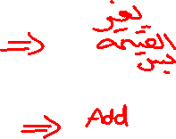
ADT List (Array): Implementation
C
public T retrieve () {
return nodes[current];
}
public void update (T val) {
nodes[current] = val;
}
public void insert (T val) {
for (int i = size-1; i > current; --i) {
nodes[i+1] = nodes[i];
}
current++;
nodes[current] = val;
size++;
}
…
0
1
2
3
n-1
val
size
3
max
n

Slide 85
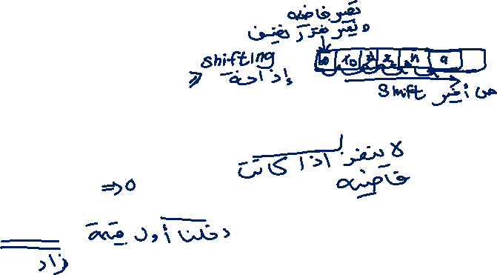
ADT List (Array): Implementation
C
public T retrieve () {
return nodes[current];
}
public void update (T val) {
nodes[current] = val;
}
public void insert (T val) {
for (int i = size-1; i > current; --i) {
nodes[i+1] = nodes[i];
}
current++;
nodes[current] = val;
size++;
}
…
0
1
2
3
n-1
size
0
max
n
Example #1

Slide 86
ADT List (Array): Implementation
C
public T retrieve () {
return nodes[current];
}
public void update (T val) {
nodes[current] = val;
}
public void insert (T val) {
for (int i = size-1; i > current; --i) {
nodes[i+1] = nodes[i];
}
current++;
nodes[current] = val;
size++;
}
…
0
1
2
3
n-1
size
0
max
n
Example #1

Slide 87
ADT List (Array): Implementation
C
public T retrieve () {
return nodes[current];
}
public void update (T val) {
nodes[current] = val;
}
public void insert (T val) {
for (int i = size-1; i > current; --i) {
nodes[i+1] = nodes[i];
}
current++;
nodes[current] = val;
size++;
}
…
0
1
2
3
n-1
size
0
max
n
Example #1

Slide 88
ADT List (Array): Implementation
C
public T retrieve () {
return nodes[current];
}
public void update (T val) {
nodes[current] = val;
}
public void insert (T val) {
for (int i = size-1; i > current; --i) {
nodes[i+1] = nodes[i];
}
current++;
nodes[current] = val;
size++;
}
…
0
1
2
3
n-1
size
0
val
5
max
n
Example #1

Slide 89
ADT List (Array): Implementation
C
public T retrieve () {
return nodes[current];
}
public void update (T val) {
nodes[current] = val;
}
public void insert (T val) {
for (int i = size-1; i > current; --i) {
nodes[i+1] = nodes[i];
}
current++;
nodes[current] = val;
size++;
}
5
…
0
1
2
3
n-1
size
0
max
n
Example #1

Slide 90
ADT List (Array): Implementation
C
public T retrieve () {
return nodes[current];
}
public void update (T val) {
nodes[current] = val;
}
public void insert (T val) {
for (int i = size-1; i > current; --i) {
nodes[i+1] = nodes[i];
}
current++;
nodes[current] = val;
size++;
}
5
…
0
1
2
3
n-1
size
1
max
n
Example #1

Slide 91
ADT List (Array): Implementation
C
public T retrieve () {
return nodes[current];
}
public void update (T val) {
nodes[current] = val;
}
public void insert (T val) {
for (int i = size-1; i > current; --i) {
nodes[i+1] = nodes[i];
}
current++;
nodes[current] = val;
size++;
}
5
…
0
1
2
3
n-1
size
1
max
n
Example #2

Slide 92
ADT List (Array): Implementation
C
public T retrieve () {
return nodes[current];
}
public void update (T val) {
nodes[current] = val;
}
public void insert (T val) {
for (int i = size-1; i > current; --i) {
nodes[i+1] = nodes[i];
}
current++;
nodes[current] = val;
size++;
}
5
…
0
1
2
3
n-1
size
1
max
n
Example #2

Slide 93

ADT List (Array): Implementation
C
public T retrieve () {
return nodes[current];
}
public void update (T val) {
nodes[current] = val;
}
public void insert (T val) {
for (int i = size-1; i > current; --i) {
nodes[i+1] = nodes[i];
}
current++;
nodes[current] = val;
size++;
}
5
…
0
1
2
3
n-1
size
1
max
n
Example #2

Slide 94
ADT List (Array): Implementation
C
public T retrieve () {
return nodes[current];
}
public void update (T val) {
nodes[current] = val;
}
public void insert (T val) {
for (int i = size-1; i > current; --i) {
nodes[i+1] = nodes[i];
}
current++;
nodes[current] = val;
size++;
}
5
…
0
1
2
3
n-1
size
1
val
8
max
n
Example #2

Slide 95
ADT List (Array): Implementation
C
public T retrieve () {
return nodes[current];
}
public void update (T val) {
nodes[current] = val;
}
public void insert (T val) {
for (int i = size-1; i > current; --i) {
nodes[i+1] = nodes[i];
}
current++;
nodes[current] = val;
size++;
}
5
8
…
0
1
2
3
n-1
size
1
max
n
Example #2

Slide 96
ADT List (Array): Implementation
C
public T retrieve () {
return nodes[current];
}
public void update (T val) {
nodes[current] = val;
}
public void insert (T val) {
for (int i = size-1; i > current; --i) {
nodes[i+1] = nodes[i];
}
current++;
nodes[current] = val;
size++;
}
5
8
…
0
1
2
3
n-1
size
2
max
n
Example #2

Slide 97
ADT List (Array): Implementation
C
public T retrieve () {
return nodes[current];
}
public void update (T val) {
nodes[current] = val;
}
public void insert (T val) {
for (int i = size-1; i > current; --i) {
nodes[i+1] = nodes[i];
}
current++;
nodes[current] = val;
size++;
}
5
8
7
…
0
1
2
3
n-1
size
3
max
n
Example #3

Slide 98
ADT List (Array): Implementation
C
i
i+1
public T retrieve () {
return nodes[current];
}
public void update (T val) {
nodes[current] = val;
}
public void insert (T val) {
for (int i = size-1; i > current; --i) {
nodes[i+1] = nodes[i];
}
current++;
nodes[current] = val;
size++;
}
5
8
7
…
0
1
2
3
n-1
size
3
max
n
Example #3

Slide 99
ADT List (Array): Implementation
C
i
i+1
public T retrieve () {
return nodes[current];
}
public void update (T val) {
nodes[current] = val;
}
public void insert (T val) {
for (int i = size-1; i > current; --i) {
nodes[i+1] = nodes[i];
}
current++;
nodes[current] = val;
size++;
}
5
8
7
7
…
0
1
2
3
n-1
size
3
max
n
Example #3

Slide 100
ADT List (Array): Implementation
C
i
i+1
public T retrieve () {
return nodes[current];
}
public void update (T val) {
nodes[current] = val;
}
public void insert (T val) {
for (int i = size-1; i > current; --i) {
nodes[i+1] = nodes[i];
}
current++;
nodes[current] = val;
size++;
}
5
8
7
7
…
0
1
2
3
n-1
size
3
max
n
Example #3

Slide 101
ADT List (Array): Implementation
C
i
i+1
public T retrieve () {
return nodes[current];
}
public void update (T val) {
nodes[current] = val;
}
public void insert (T val) {
for (int i = size-1; i > current; --i) {
nodes[i+1] = nodes[i];
}
current++;
nodes[current] = val;
size++;
}
5
8
8
7
…
0
1
2
3
n-1
size
3
max
n
Example #3

Slide 102
ADT List (Array): Implementation
C
public T retrieve () {
return nodes[current];
}
public void update (T val) {
nodes[current] = val;
}
public void insert (T val) {
for (int i = size-1; i > current; --i) {
nodes[i+1] = nodes[i];
}
current++;
nodes[current] = val;
size++;
}
5
8
8
7
…
0
1
2
3
n-1
size
3
max
n
Example #3

Slide 103
ADT List (Array): Implementation
C
public T retrieve () {
return nodes[current];
}
public void update (T val) {
nodes[current] = val;
}
public void insert (T val) {
for (int i = size-1; i > current; --i) {
nodes[i+1] = nodes[i];
}
current++;
nodes[current] = val;
size++;
}
5
8
8
7
…
0
1
2
3
n-1
val
6
size
3
max
n
Example #3

Slide 104
ADT List (Array): Implementation
C
public T retrieve () {
return nodes[current];
}
public void update (T val) {
nodes[current] = val;
}
public void insert (T val) {
for (int i = size-1; i > current; --i) {
nodes[i+1] = nodes[i];
}
current++;
nodes[current] = val;
size++;
}
5
6
8
7
…
0
1
2
3
n-1
size
3
max
n
Example #3

Slide 105

ADT List (Array): Implementation
C
public T retrieve () {
return nodes[current];
}
public void update (T val) {
nodes[current] = val;
}
public void insert (T val) {
for (int i = size-1; i > current; --i) {
nodes[i+1] = nodes[i];
}
current++;
nodes[current] = val;
size++;
}
5
6
8
7
…
0
1
2
3
n-1
size
3
max
n
Example #3

Slide 106
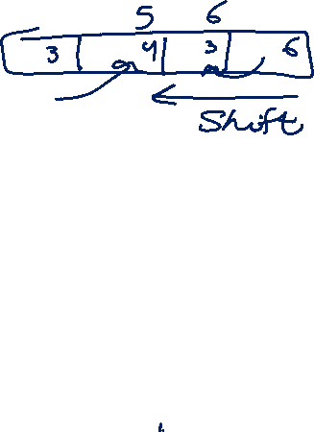
ADT List (Array): Implementation
public void remove () {
for (int i = current + 1; i < size; i++) {
nodes[i-1] = nodes[i];
}
size--;
if (size == 0)
current = -1;
else if (current == size)
current = 0;
}
}

Slide 107

ADT List (Array): Implementation
public void remove () {
for (int i = current + 1; i < size; i++) {
nodes[i-1] = nodes[i];
}
size--;
if (size == 0)
current = -1;
else if (current == size)
current = 0;
}
}
C
5
…
0
1
2
3
n-1
size
1
max
n
Example #1

Slide 108
ADT List (Array): Implementation
public void remove () {
for (int i = current + 1; i < size; i++) {
nodes[i-1] = nodes[i];
}
size--;
if (size == 0)
current = -1;
else if (current == size)
current = 0;
}
}
C
5
…
0
1
2
3
n-1
size
1
max
n
Example #1

Slide 109
ADT List (Array): Implementation
public void remove () {
for (int i = current + 1; i < size; i++) {
nodes[i-1] = nodes[i];
}
size--;
if (size == 0)
current = -1;
else if (current == size)
current = 0;
}
}
C
5
…
0
1
2
3
n-1
size
0
max
n
Example #1

Slide 110
ADT List (Array): Implementation
public void remove () {
for (int i = current + 1; i < size; i++) {
nodes[i-1] = nodes[i];
}
size--;
if (size == 0)
current = -1;
else if (current == size)
current = 0;
}
}
C
5
…
0
1
2
3
n-1
size
0
max
n
Example #1

Slide 111
ADT List (Array): Implementation
public void remove () {
for (int i = current + 1; i < size; i++) {
nodes[i-1] = nodes[i];
}
size--;
if (size == 0)
current = -1;
else if (current == size)
current = 0;
}
}
C
5
6
8
7
…
0
1
2
3
n-1
size
4
max
n
Example #2

Slide 112
ADT List (Array): Implementation
public void remove () {
for (int i = current + 1; i < size; i++) {
nodes[i-1] = nodes[i];
}
size--;
if (size == 0)
current = -1;
else if (current == size)
current = 0;
}
}
i-1
i
C
5
6
8
7
…
0
1
2
3
n-1
size
4
max
n
Example #2

Slide 113
ADT List (Array): Implementation
public void remove () {
for (int i = current + 1; i < size; i++) {
nodes[i-1] = nodes[i];
}
size--;
if (size == 0)
current = -1;
else if (current == size)
current = 0;
}
}
i-1
i
C
6
6
8
7
…
0
1
2
3
n-1
size
4
max
n
Example #2

Slide 114
ADT List (Array): Implementation
public void remove () {
for (int i = current + 1; i < size; i++) {
nodes[i-1] = nodes[i];
}
size--;
if (size == 0)
current = -1;
else if (current == size)
current = 0;
}
}
i-1
i
C
6
6
8
7
…
0
1
2
3
n-1
size
4
max
n
Example #2

Slide 115
ADT List (Array): Implementation
public void remove () {
for (int i = current + 1; i < size; i++) {
nodes[i-1] = nodes[i];
}
size--;
if (size == 0)
current = -1;
else if (current == size)
current = 0;
}
}
i-1
i
C
6
8
8
7
…
0
1
2
3
n-1
size
4
max
n
Example #2

Slide 116
ADT List (Array): Implementation
public void remove () {
for (int i = current + 1; i < size; i++) {
nodes[i-1] = nodes[i];
}
size--;
if (size == 0)
current = -1;
else if (current == size)
current = 0;
}
}
i-1
i
C
6
8
8
7
…
0
1
2
3
n-1
size
4
max
n
Example #2

Slide 117
ADT List (Array): Implementation
public void remove () {
for (int i = current + 1; i < size; i++) {
nodes[i-1] = nodes[i];
}
size--;
if (size == 0)
current = -1;
else if (current == size)
current = 0;
}
}
i-1
i
C
6
8
7
7
…
0
1
2
3
n-1
size
4
max
n
Example #2

Slide 118
ADT List (Array): Implementation
public void remove () {
for (int i = current + 1; i < size; i++) {
nodes[i-1] = nodes[i];
}
size--;
if (size == 0)
current = -1;
else if (current == size)
current = 0;
}
}
C
6
8
7
7
…
0
1
2
3
n-1
size
3
max
n
Example #2

Slide 119
ADT List (Array): Implementation
public void remove () {
for (int i = current + 1; i < size; i++) {
nodes[i-1] = nodes[i];
}
size--;
if (size == 0)
current = -1;
else if (current == size)
current = 0;
}
}
C
6
8
7
…
0
1
2
3
n-1
size
3
max
n
Example #3

Slide 120
ADT List (Array): Implementation
public void remove () {
for (int i = current + 1; i < size; i++) {
nodes[i-1] = nodes[i];
}
size--;
if (size == 0)
current = -1;
else if (current == size)
current = 0;
}
}
C
6
8
7
…
0
1
2
3
n-1
size
3
max
n
Example #3

Slide 121

ADT List (Array): Implementation
public void remove () {
for (int i = current + 1; i < size; i++) {
nodes[i-1] = nodes[i];
}
size--;
if (size == 0)
current = -1;
else if (current == size)
current = 0;
}
}
C
6
8
7
…
0
1
2
3
n-1
size
2
max
n
Example #3

Slide 122
ADT List (Array): Implementation
public void remove () {
for (int i = current + 1; i < size; i++) {
nodes[i-1] = nodes[i];
}
size--;
if (size == 0)
current = -1;
else if (current == size)
current = 0;
}
}
C
6
8
7
…
0
1
2
3
n-1
size
2
max
n
Example #3

Slide 123

ADT List
How to use the ADT List?
The implementation of ADT is available to you as a Java class ready for use.
Example: You are required to implement a static method to get the length of a list.

Slide 124
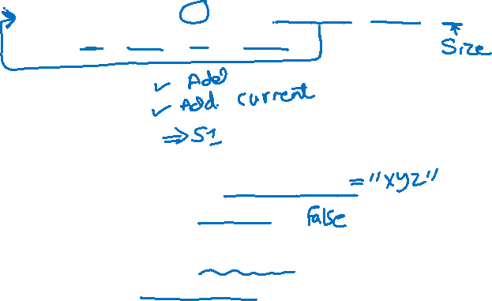
Using ADT List
public class TestArrayList {
public static void main ( String[] args ) {
ArrayList<String> al = new ArrayList<String>(10);
String s1= "xyz", s2 = "abc";
al.insert(s1);
al.insert(s2);
al.findFirst();
System.out.println(al.retrieve());
System.out.println(al.full());
System.out.println(length(al));
System.out.println("Hello, World");
}

Slide 125
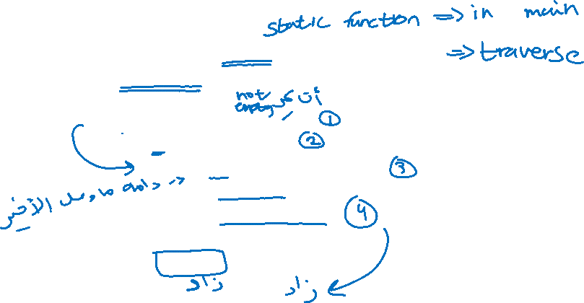
Using ADT List
public static <T> int length(ArrayList<T> l) {
int count = 0;
if (l.empty() == false) {
l.findFirst();
while (l.last() == false) {
count++;
l.findNext();
}
count++;
}
return count;
}
}
A static method
to find the length
of a list.
Note: it has been implemented using the methods of ADT List

Slide 126
Using ADT List
public class TestArrayList {
public static void main ( String[] args ) {
ArrayList<String> al = new ArrayList<String>(10);
String s1= "xyz", s2 = "abc";
al.insert(s1);
al.insert(s2);
al.findFirst();
System.out.println(al.retrieve());
System.out.println(al.full());
System.out.println(length(al));
System.out.println("Hello, World");
}
C
…
0
1
2
3
9
size
0
max
10
Output:

Slide 127
Using ADT List
public class TestArrayList {
public static void main ( String[] args ) {
ArrayList<String> al = new ArrayList<String>(10);
String s1= "xyz", s2 = "abc";
al.insert(s1);
al.insert(s2);
al.findFirst();
System.out.println(al.retrieve());
System.out.println(al.full());
System.out.println(length(al));
System.out.println("Hello, World");
}
a1
C
…
0
1
2
3
9
size
0
max
10
Output:

Slide 128
Using ADT List
public class TestArrayList {
public static void main ( String[] args ) {
ArrayList<String> al = new ArrayList<String>(10);
String s1= "xyz", s2 = "abc";
al.insert(s1);
al.insert(s2);
al.findFirst();
System.out.println(al.retrieve());
System.out.println(al.full());
System.out.println(length(al));
System.out.println("Hello, World");
}
a1
C
xyz
…
0
1
2
3
9
size
1
max
10
Output:

Slide 129
Using ADT List
public class TestArrayList {
public static void main ( String[] args ) {
ArrayList<String> al = new ArrayList<String>(10);
String s1= "xyz", s2 = "abc";
al.insert(s1);
al.insert(s2);
al.findFirst();
System.out.println(al.retrieve());
System.out.println(al.full());
System.out.println(length(al));
System.out.println("Hello, World");
}
a1
C
xyz
abc
…
0
1
2
3
9
size
2
max
10
Output:

Slide 130

Using ADT List
public class TestArrayList {
public static void main ( String[] args ) {
ArrayList<String> al = new ArrayList<String>(10);
String s1= "xyz", s2 = "abc";
al.insert(s1);
al.insert(s2);
al.findFirst();
System.out.println(al.retrieve());
System.out.println(al.full());
System.out.println(length(al));
System.out.println("Hello, World");
}
a1
C
xyz
abc
…
0
1
2
3
9
size
2
max
10
Output:

Slide 131
Using ADT List
public class TestArrayList {
public static void main ( String[] args ) {
ArrayList<String> al = new ArrayList<String>(10);
String s1= "xyz", s2 = "abc";
al.insert(s1);
al.insert(s2);
al.findFirst();
System.out.println(al.retrieve());
System.out.println(al.full());
System.out.println(length(al));
System.out.println("Hello, World");
}
a1
C
xyz
abc
…
0
1
2
3
9
size
2
max
10
Output:
xyz
false

Slide 132
Using ADT List
public class TestArrayList {
public static void main ( String[] args ) {
ArrayList<String> al = new ArrayList<String>(10);
String s1= "xyz", s2 = "abc";
al.insert(s1);
al.insert(s2);
al.findFirst();
System.out.println(al.retrieve());
System.out.println(al.full());
System.out.println(length(al));
System.out.println("Hello, World");
}
a1
C
xyz
abc
…
0
1
2
3
9
size
2
max
10
Output:
xyz
false

Slide 133
Using ADT List
public static <T> int length(ArrayList<T> l) {
int count = 0;
if (!l.empty()) {
l.findFirst();
while (l.last() == false) {
count++;
l.findNext();
}
count++;
}
return count;
}
}
a1
C
xyz
abc
…
0
1
2
3
9
size
2
max
10
Output:
xyz
false

Slide 134
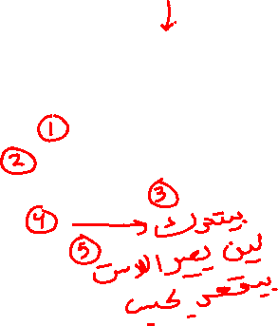
Using ADT List
public static <T> int length(ArrayList<T> l) {
int count = 0;
if (l.empty() == false) {
l.findFirst();
while (l.last() == false) {
count++;
l.findNext();
}
count++;
}
return count;
}
}
a1
count = 0
l
C
xyz
abc
…
0
1
2
3
9
size
2
max
10
Output:
xyz
false

Slide 135
Using ADT List
public static <T> int length(ArrayList<T> l) {
int count = 0;
if (l.empty() == false) {
l.findFirst();
while (l.last() == false) {
count++;
l.findNext();
}
count++;
}
return count;
}
}
a1
count = 0
l
C
xyz
abc
…
0
1
2
3
9
size
2
max
10
Output:
xyz
false

Slide 136
Using ADT List
public static <T> int length(ArrayList<T> l) {
int count = 0;
if (l.empty() == false) {
l.findFirst();
while (l.last() == false) {
count++;
l.findNext();
}
count++;
}
return count;
}
}
a1
count = 1
l
C
xyz
abc
…
0
1
2
3
9
size
2
max
10
Output:
xyz
false

Slide 137
Using ADT List
public static<T> int length(ArrayList<T> l) {
int count = 0;
if (l.empty() == false) {
l.findFirst();
while (l.last() == false) {
count++;
l.findNext();
}
count++;
}
return count;
}
}
a1
count = 1
l
C
xyz
abc
…
0
1
2
3
9
size
2
max
10
Output:
xyz
false

Slide 138
Using ADT List
public static <T> int length(ArrayList<T> l) {
int count = 0;
if (l.empty() == false) {
l.findFirst();
while (l.last() == false) {
count++;
l.findNext();
}
count++;
}
return count;
}
}
a1
count = 2
l
C
xyz
abc
…
0
1
2
3
9
size
2
max
10
Output:
xyz
false

Slide 139
Using ADT List
public static <T> int length(ArrayList<T> l) {
int count = 0;
if (l.empty() == false) {
l.findFirst();
while (l.last() == false) {
count++;
l.findNext();
}
count++;
}
return count;
}
}
a1
count = 2
l
C
xyz
abc
…
0
1
2
3
9
size
2
max
10
Output:
xyz
false

Slide 140

Using ADT List
public class TestArrayList {
public static void main ( String[] args ) {
ArrayList<String> al = new ArrayList<String>(10);
String s1= "xyz", s2 = "abc";
al.insert(s1);
al.insert(s2);
al.findFirst();
System.out.println(al.retrieve());
System.out.println(al.full());
System.out.println(length(al));
System.out.println("Hello, World");
}
a1
C
xyz
abc
…
0
1
2
3
9
size
2
max
10
Output:
xyz
false
2
Hello, World

Slide 141
ADT List
What are the changes that need to be made to use List (Linked List implementation) instead of List (Array List implementation)?

Slide 142
Using ADT List
public class TestLinkedList {
public static void main ( String[] args ) {
ArrayList<String> al = new ArrayList<String>(10);
LinkedList<String> al = new LinkedList<String>();
String s1= "xyz", s2 = "abc";
al.insert(s1);
al.insert(s2);
al.findFirst();
System.out.println(al.retrieve());
System.out.println(al.full());
System.out.println(length(al));
System.out.println("Hello, World");
}
Only this line!

Slide 143

ADT List
You are required to implement a static method to search for an element e in a list L, and if e is present make current pointer point to e. Use operations of ADT List.

Slide 144
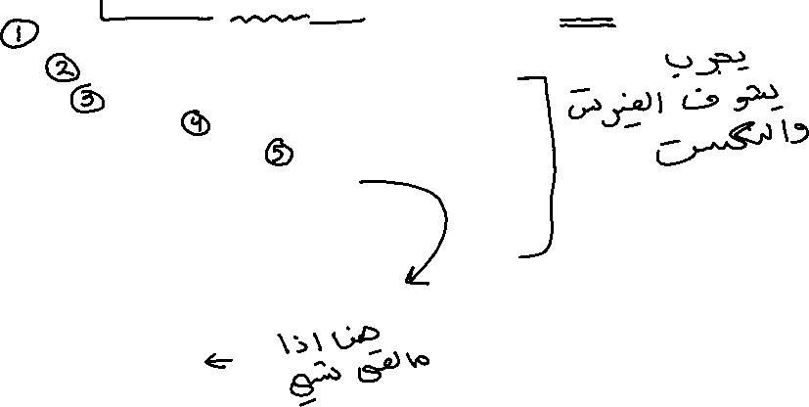
Search Item (Static Method)
...
public static <T> boolean find(ArrayList<T> l, T key) {
if(l.empty() == false) {
l.findFirst();
while(l.last() == false) {
if(l.retrieve().equals(key))
return true;
l.findNext();
}
if(l.retrieve().equals(key))
return true;
}
return false;
}
...

Slide 145
Search Item (Static Method)
...
public static <T> boolean find(ArrayList<T> l, T key) {
if(l.empty() == false) {
l.findFirst();
while(l.last() == false) {
if(l.retrieve().equals(key))
return true;
l.findNext();
}
if(l.retrieve().equals(key))
return true;
}
return false;
}
...
Example #1
key
c
1
C
a
b
c
d
…
0
1
2
3
n-1
size
4
max
n

Slide 146
Search Item (Static Method)
...
public static<T> boolean find(ArrayList<T> l, T key) {
if(l.empty() == false) {
l.findFirst();
while(l.last() == false) {
if(l.retrieve().equals(key))
return true;
l.findNext();
}
if(l.retrieve().equals(key))
return true;
}
return false;
}
...
Example #1
key
c
1
C
a
b
c
d
…
0
1
2
3
n-1
size
4
max
n

Slide 147
Search Item (Static Method)
...
public static <T> boolean find(ArrayList<T> l, T key) {
if(l.empty() == false) {
l.findFirst();
while(l.last() == false) {
if(l.retrieve().equals(key))
return true;
l.findNext();
}
if(l.retrieve().equals(key))
return true;
}
return false;
}
...
Example #1
key
c
1
C
a
b
c
d
…
0
1
2
3
n-1
size
4
max
n

Slide 148
Search Item (Static Method)
...
public static <T> boolean find(ArrayList<T> l, T key) {
if(l.empty() == false) {
l.findFirst();
while(l.last() == false) {
if(l.retrieve().equals(key))
return true;
l.findNext();
}
if(l.retrieve().equals(key))
return true;
}
return false;
}
...
Example #1
key
c
1
C
a
b
c
d
…
0
1
2
3
n-1
size
4
max
n

Slide 149
Search Item (Static Method)
...
public static <T> boolean find(ArrayList<T> l, T key) {
if(l.empty() == false) {
l.findFirst();
while(l.last() == false) {
if(l.retrieve().equals(key))
return true;
l.findNext();
}
if(l.retrieve().equals(key))
return true;
}
return false;
}
...
Example #1
key
c
1
C
a
b
c
d
…
0
1
2
3
n-1
size
4
max
n

Slide 150
Search Item (Static Method)
...
public static <T> boolean find(ArrayList<T> l, T key) {
if(l.empty() == false) {
l.findFirst();
while(l.last() == false) {
if(l.retrieve().equals(key))
return true;
l.findNext();
}
if(l.retrieve().equals(key))
return true;
}
return false;
}
...
Example #1
key
c
1
C
a
b
c
d
…
0
1
2
3
n-1
size
4
max
n

Slide 151
Search Item (Static Method)
...
public static <T> boolean find(ArrayList<T> l, T key) {
if(l.empty() == false) {
l.findFirst();
while(l.last() == false) {
if(l.retrieve().equals(key))
return true;
l.findNext();
}
if(l.retrieve().equals(key))
return true;
}
return false;
}
...
Example #1
key
c
1
C
a
b
c
d
…
0
1
2
3
n-1
size
4
max
n

Slide 152
Search Item (Static Method)
...
public static <T> boolean find(ArrayList<T> l, T key) {
if(l.empty() == false) {
l.findFirst();
while(l.last() == false) {
if(l.retrieve().equals(key))
return true;
l.findNext();
}
if(l.retrieve().equals(key))
return true;
}
return false;
}
...
Example #1
key
c
1
C
a
b
c
d
…
0
1
2
3
n-1
size
4
max
n

Slide 153
Search Item (Static Method)
...
public static <T> boolean find(ArrayList<T> l, T key) {
if(l.empty() == false) {
l.findFirst();
while(l.last() == false) {
if(l.retrieve().equals(key))
return true;
l.findNext();
}
if(l.retrieve().equals(key))
return true;
}
return false;
}
...
Example #2
key
d
1
C
a
b
c
d
…
0
1
2
3
n-1
size
4
max
n

Slide 154
Search Item (Static Method)
...
public static <T> boolean find(ArrayList<T> l, T key) {
if(l.empty() == false) {
l.findFirst();
while(l.last() == false) {
if(l.retrieve().equals(key))
return true;
l.findNext();
}
if(l.retrieve().equals(key))
return true;
}
return false;
}
...
Example #2
key
d
1
C
a
b
c
d
…
0
1
2
3
n-1
size
4
max
n

Slide 155
Search Item (Static Method)
...
public static <T> boolean find(ArrayList<T> l, T key) {
if(l.empty() == false) {
l.findFirst();
while(l.last() == false) {
if(l.retrieve().equals(key))
return true;
l.findNext();
}
if(l.retrieve().equals(key))
return true;
}
return false;
}
...
Example #2
key
d
1
C
a
b
c
d
…
0
1
2
3
n-1
size
4
max
n

Slide 156
Search Item (Static Method)
...
public static <T> boolean find(ArrayList<T> l, T key) {
if(l.empty() == false) {
l.findFirst();
while(l.last() == false) {
if(l.retrieve().equals(key))
return true;
l.findNext();
}
if(l.retrieve().equals(key))
return true;
}
return false;
}
...
Example #2
key
d
1
C
a
b
c
d
…
0
1
2
3
n-1
size
4
max
n

Slide 157
Search Item (Static Method)
...
public static <T> boolean find(ArrayList<T> l, T key) {
if(l.empty() == false) {
l.findFirst();
while(l.last() == false) {
if(l.retrieve().equals(key))
return true;
l.findNext();
}
if(l.retrieve().equals(key))
return true;
}
return false;
}
...
Example #2
key
d
1
C
a
b
c
d
…
0
1
2
3
n-1
size
4
max
n

Slide 158
Search Item (Static Method)
...
public static <T> boolean find(ArrayList<T> l, T key) {
if(l.empty() == false) {
l.findFirst();
while(l.last() == false) {
if(l.retrieve().equals(key))
return true;
l.findNext();
}
if(l.retrieve().equals(key))
return true;
}
return false;
}
...
Example #2
key
d
1
C
a
b
c
d
…
0
1
2
3
n-1
size
4
max
n

Slide 159
Search Item (Static Method)
...
public static <T> boolean find(ArrayList<T> l, T key) {
if(l.empty() == false) {
l.findFirst();
while(l.last() == false) {
if(l.retrieve().equals(key))
return true;
l.findNext();
}
if(l.retrieve().equals(key))
return true;
}
return false;
}
...
Example #2
key
d
1
C
a
b
c
d
…
0
1
2
3
n-1
size
4
max
n

Slide 160
Search Item (Static Method)
...
public static <T> boolean find(ArrayList<T> l, T key) {
if(l.empty() == false) {
l.findFirst();
while(l.last() == false) {
if(l.retrieve().equals(key))
return true;
l.findNext();
}
if(l.retrieve().equals(key))
return true;
}
return false;
}
...
Example #2
key
d
1
C
a
b
c
d
…
0
1
2
3
n-1
size
4
max
n

Slide 161
Search Item (Static Method)
...
public static <T> boolean find(ArrayList<T> l, T key) {
if(l.empty() == false) {
l.findFirst();
while(l.last() == false) {
if(l.retrieve().equals(key))
return true;
l.findNext();
}
if(l.retrieve().equals(key))
return true;
}
return false;
}
...
Example #2
key
d
1
C
a
b
c
d
…
0
1
2
3
n-1
size
4
max
n

Slide 162
Search Item (Static Method)
...
public static <T> boolean find(ArrayList<T> l, T key) {
if(l.empty() == false) {
l.findFirst();
while(l.last() == false) {
if(l.retrieve().equals(key))
return true;
l.findNext();
}
if(l.retrieve().equals(key))
return true;
}
return false;
}
...
Example #2
key
d
1
C
a
b
c
d
…
0
1
2
3
n-1
size
4
max
n

Slide 163
Search Item (Static Method)
...
public static <T> boolean find(ArrayList<T> l, T key) {
if(l.empty() == false) {
l.findFirst();
while(l.last() == false) {
if(l.retrieve().equals(key))
return true;
l.findNext();
}
if(l.retrieve().equals(key))
return true;
}
return false;
}
...
Example #3
key
x
1
C
a
b
…
0
1
2
3
n-1
size
2
max
n

Slide 164
Search Item (Static Method)
...
public static <T> boolean find(ArrayList<T> l, T key) {
if(l.empty() == false) {
l.findFirst();
while(l.last() == false) {
if(l.retrieve().equals(key))
return true;
l.findNext();
}
if(l.retrieve().equals(key))
return true;
}
return false;
}
...
Example #3
key
x
1
C
a
b
…
0
1
2
3
n-1
size
2
max
n

Slide 165
Search Item (Static Method)
...
public static <T> boolean find(ArrayList<T> l, T key) {
if(l.empty() == false) {
l.findFirst();
while(l.last() == false) {
if(l.retrieve().equals(key))
return true;
l.findNext();
}
if(l.retrieve().equals(key))
return true;
}
return false;
}
...
Example #3
key
x
1
C
a
b
…
0
1
2
3
n-1
size
2
max
n

Slide 166
Search Item (Static Method)
...
public static <T> boolean find(ArrayList<T> l, T key) {
if(l.empty() == false) {
l.findFirst();
while(l.last() == false) {
if(l.retrieve().equals(key))
return true;
l.findNext();
}
if(l.retrieve().equals(key))
return true;
}
return false;
}
...
Example #3
key
x
1
C
a
b
…
0
1
2
3
n-1
size
2
max
n

Slide 167
Search Item (Static Method)
...
public static <T> boolean find(ArrayList<T> l, T key) {
if(l.empty() == false) {
l.findFirst();
while(l.last() == false) {
if(l.retrieve().equals(key))
return true;
l.findNext();
}
if(l.retrieve().equals(key))
return true;
}
return false;
}
...
Example #3
key
x
1
C
a
b
…
0
1
2
3
n-1
size
2
max
n

Slide 168
Search Item (Static Method)
...
public static <T> boolean find(ArrayList<T> l, T key) {
if(l.empty() == false) {
l.findFirst();
while(l.last() == false) {
if(l.retrieve().equals(key))
return true;
l.findNext();
}
if(l.retrieve().equals(key))
return true;
}
return false;
}
...
Example #3
key
x
1
C
a
b
…
0
1
2
3
n-1
size
2
max
n

Slide 169
Search Item (Static Method)
...
public static <T> boolean find(ArrayList<T> l, T key) {
if(l.empty() == false) {
l.Findfirst();
while(l.last() == false) {
if(l.retrieve().equals(key))
return true;
l.findNext();
}
if(l.retrieve().equals(key))
return true;
}
return false;
}
...
Example #4
key
a
1
C
…
0
1
2
3
n-1
size
0
max
n

Slide 170
Search Item (Static Method)
...
public static <T> boolean find(ArrayList<T> l, T key) {
if(l.empty() == false) {
l.findFirst();
while(l.last() == false) {
if(l.retrieve().equals(key))
return true;
l.findNext();
}
if(l.retrieve().equals(key))
return true;
}
return false;
}
...
Example #4
key
a
1
C
…
0
1
2
3
n-1
size
0
max
n

Slide 171
ADT List
You are required to implement the same search method but this time as a member method of the ADT List (Linked List implementation).

Slide 172
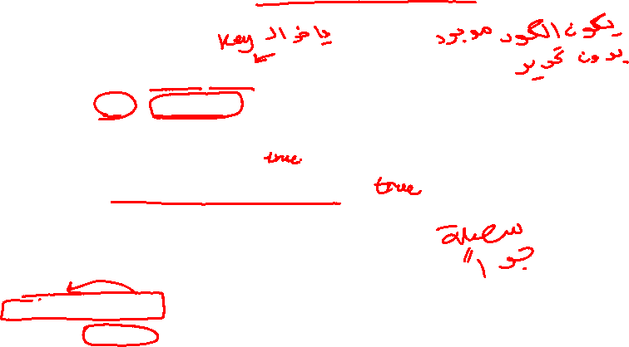
Search Item (Member Method) #1
...
public boolean find(T key) {
Node<T> tmp = current;
current = head;
while(current != null) {
if(current.data.equals(key))
return true;
current = current.next;
}
current = tmp;
return false;
}
...

Slide 173

Search Item (Member Method) #2
...
public boolean find(T key) {
Node<T> tmp = head;
while(tmp != null) {
if(tmp.data.equals(key)) {
current = tmp;
return true;
}
tmp = tmp.next;
}
return false;
}
...

Slide 174
Search Item (Member Method) #3
...
public boolean find(T key) {
if(empty() == false) {
findFirst();
while(last() == false) {
if(retrieve().equals(key))
return true;
findNext();
}
if(retrieve().equals(key))
return true;
}
return false;
}
...

Slide 175

Comparison: Linked & Array Based Lists
Comparison on the basis:
worst case time complexity operations
  Linked List: insert– O(1); remove – O(n).
  Array List: insert – O(n); remove – O(n).
  All other operations have time complexity O(1).
Best case time complexities?

Slide 176

Comparison: Linked & Array Based Lists
Linked List.
  Advantages: No need to know the size in advance. Fast “Insert” – O(1).
  Disadvantage: a pointer at each node (more memory needed). For traversal, pointer hoping is required.
Array Based List.
  Advantages: No pointers to be stored (less memory). For traversal, no pointer hoping is required (array faster in traversal).
  Disadvantage: list size must be known in advance. Slow “Insert” – O(n).

Slide 177
List: Other Implementations
Singly-Linked List.
  Design Variations: (i) Count of elements may be kept i.e. size. Why? (ii) pointer to tail may be kept i.e. last. Why?
Doubly-Linked List.
  each node has two pointers: next node and previous node.
  Advantages: it is efficient to go from a node to its previous node or move back-to-front in the list
  operations insert – O(1);
  remove – O(1).
  (We will cover this topic in detail later)

Slide 178
List: Singly Linked
Head
null
Current
Singly-Linked List
Size
Head
null
Current
Singly-Linked List
(with size)

Slide 179

List: Singly Linked with Tail
Tail
Head
null
Current
Singly-Linked List
(with Tail)

Slide 180
List: Doubly-Linked
Head
null
null
Doubly-Linked List
Current

Slide 181
List: Other Implementations
List with Sentinel Nodes.
  Has special header & trailer nodes that do not store data
  All nodes that store data have previous & next nodes – so no special cases for insert & remove.
  Advantage– simplifies code
Circular List.
  tail pointer made to point to the head → tail has next node. Advantage: simpler code.

Slide 182

List: with Sentinel Nodes
Tail
Head
null
Current
List with Sentinel Nodes

Slide 183
List: Circular List
Head
Current
Circular List

